Slide 1

From AI to ML
By MXK

Slide 2


Slide 3
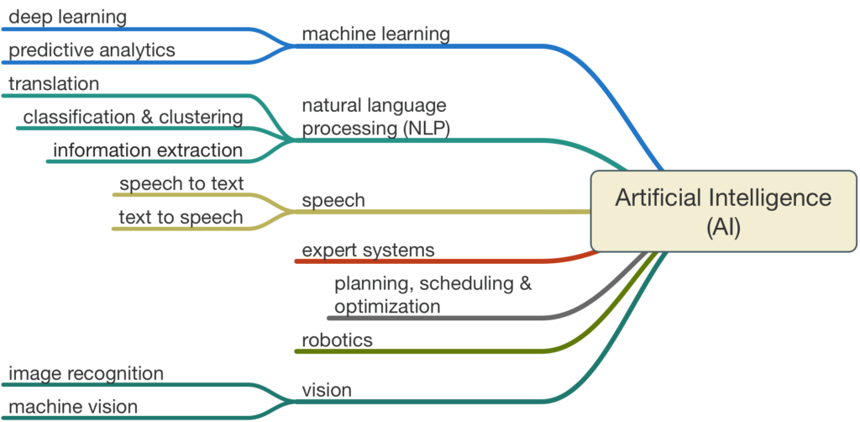

Slide 4


Slide 5
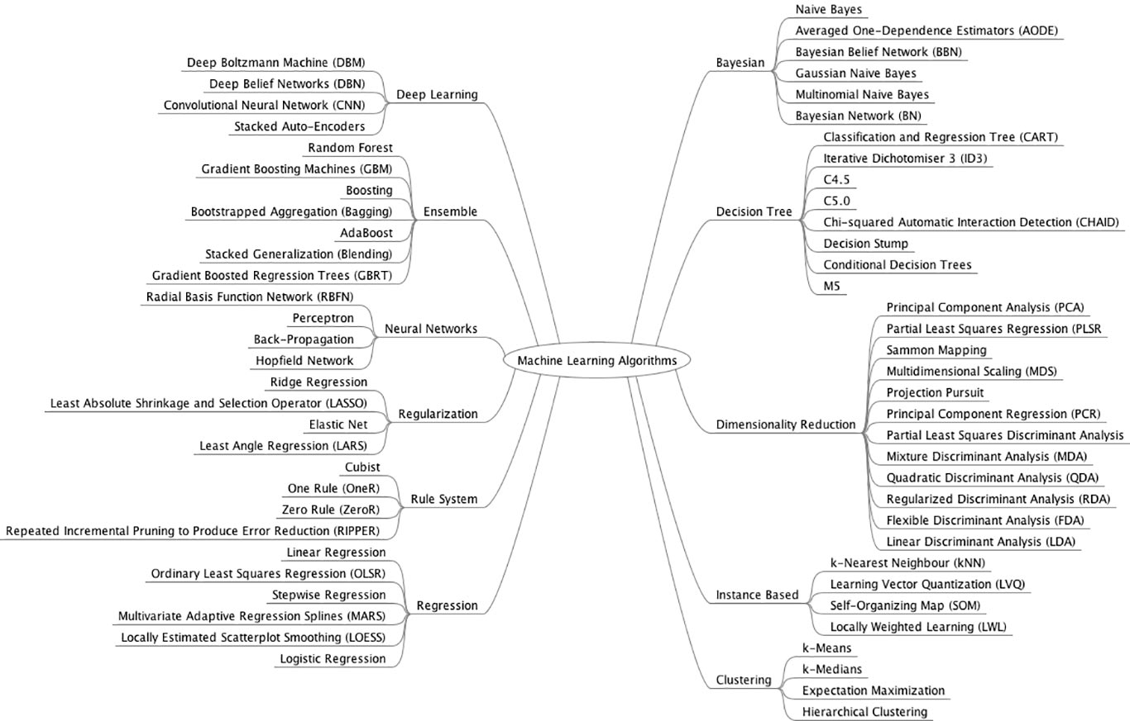

Slide 6
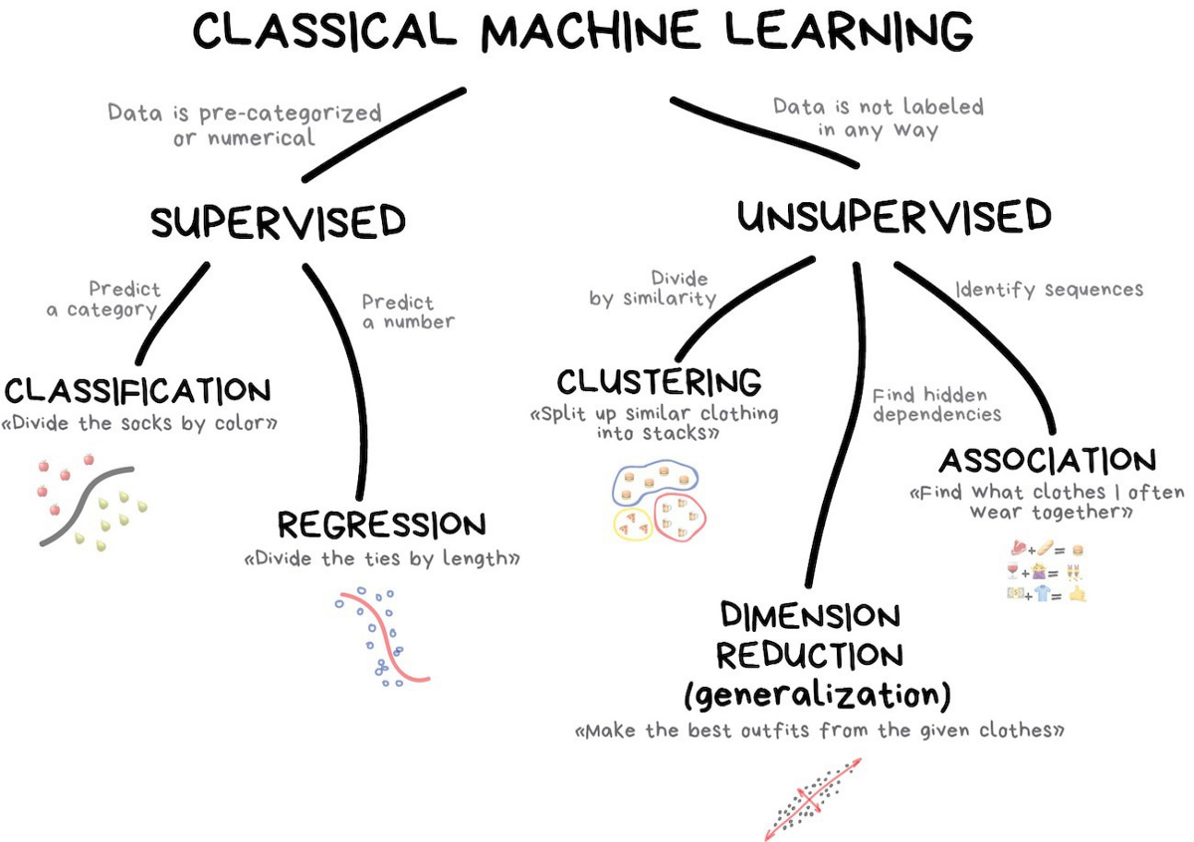

Slide 7
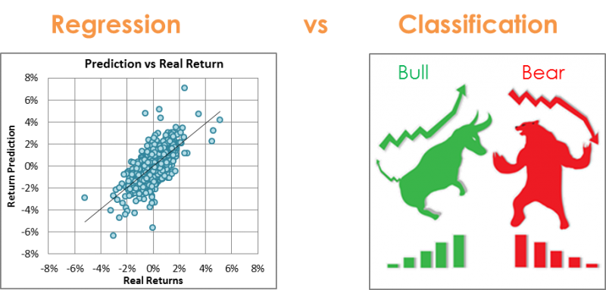
Supervised Machine Learning

Slide 8
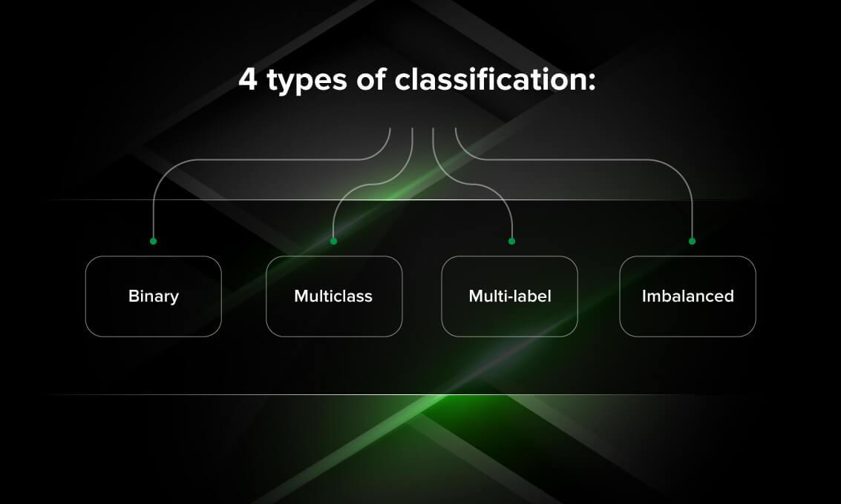

Slide 9
Binary Classification
Binary classification refers to those classification tasks that have two class labels.
Examples include:
Email spam detection (spam or not).
Churn prediction (churn or not).
Conversion prediction (buy or not).
Popular algorithms that can be used for binary classification include:
Logistic Regression
k-Nearest Neighbors
Decision Trees
Support Vector Machine
Naive Bayes
Code for a use case

Slide 10
Multi-Class Classification
Multi-class classification refers to those classification tasks that have more than two class labels.
Examples include:
Plant species classification.
Optical character recognition.
Algorithms that are designed for binary classification can be adapted for use for multi-class problems using the following techniques
One-vs-Rest: Fit one binary classification model for each class vs. all other classes.
One-vs-One: Fit one binary classification model for each pair of classes.
Popular algorithms that can be used for multi-class classification include:
Logistic Regression (binary and multi-class).
Random Forest.
Code for a use case:

Slide 11
Multi-Label Classification
Multi-label classification refers to those classification tasks that have two or more class labels, where one or more class labels may be predicted for each example.
Examples include:
Photo classifications where a given photo may have multiple objects in the scene and a model may predict the presence of multiple known objects in the photo, such as “bicycle,” “apple,” “person,” etc.
Specialized versions of standard classification algorithms can be used:
Multi-label Decision Trees.
Multi-label Random Forests.
Multi-label Gradient Boosting.
Code for a use case:

Slide 12
Imbalanced Classification
Imbalanced classification refers to classification tasks where the number of examples in each class is unequally distributed.
Examples include:
Fraud detection.
Outlier detection.
Medical diagnostic tests.
Specialized modeling algorithms may be used that pay more attention to the minority class when fitting the model on the training dataset:
Cost-sensitive Logistic Regression.
Cost-sensitive Decision Trees.
Cost-sensitive Support Vector Machines.
Code for a use case:

Slide 13
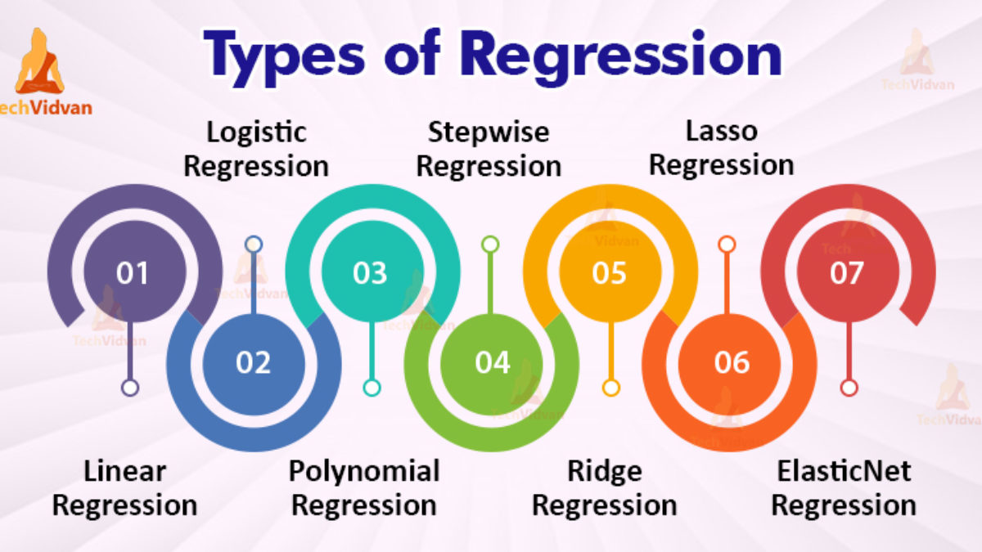

Slide 14
Types of Regression Part 1
Linear regression
is used for predictive analysis. Linear regression is a linear approach for modeling the relationship between the criterion or the scalar response and the multiple predictors or explanatory variables.
Y = bX + A.
Logistic regression
is used when the dependent variable is dichotomous. Logistic regression is used to deal with data that has two possible criterions and the relationship between the criterions and the predictors.
Y = b0 + b1X1 + b2X2.
Polynomial regression
is used for curvilinear data. Polynomial regression is fit with the method of least squares. The goal of regression analysis to model the expected value of a dependent variable y in regards to the independent variable x.
Y = b0 + b0X1 + e

Slide 15
Types of Regression Part 2
Stepwise regression
is used for fitting regression models with predictive models. It is carried out automatically. With each step, the variable is added or subtracted from the set of explanatory variables. The approaches for stepwise regression are forward selection, backward elimination, and bidirectional elimination.
Ridge regression
is a technique for analyzing multiple regression data. When multicollinearity occurs, least squares estimates are unbiased. A degree of bias is added to the regression estimates, and a result, ridge regression reduces the standard errors.

Slide 16
Types of Regression Part 3
Lasso Regression
is a regression analysis method that performs both variable selection and regularization. Lasso regression uses soft thresholding. Lasso regression selects only a subset of the provided covariates for use in the final model.
ElasticNet Regression
is a regularized regression method that linearly combines the penalties of the lasso and ridge methods. ElasticNet regression is used for support vector machines, metric learning, and portfolio optimization.

Slide 17

Notes:
Ensemble learning is the process by which multiple models, such as classifiers or experts, are strategically generated and combined to solve a particular computational intelligence problem. Ensemble learning is primarily used to improve the (classification, prediction, function approximation, etc.) performance of a model, or reduce the likelihood of an unfortunate selection of a poor one.

Slide 18
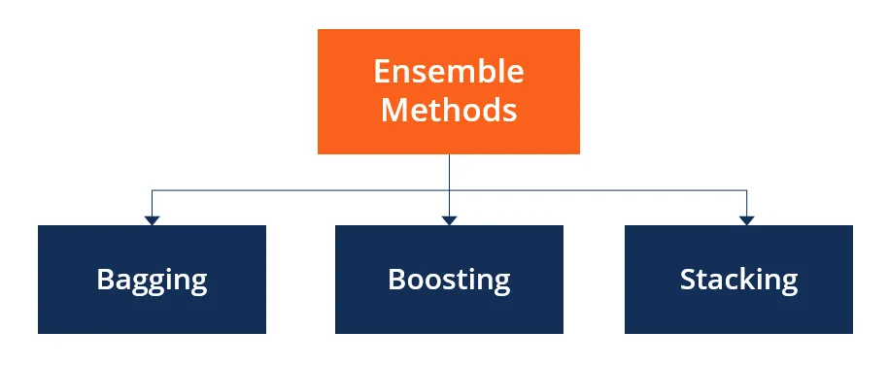
Notes:
Bagging = Bootstrap aggregating
It’s ensemble meta-algorithm designed to improve the stability and accuracy of machine learning algorithms used in statistical classification and regression. It also reduces variance and helps to avoid overfitting.
A Bagging classifier is an ensemble meta-estimator that fits base classifiers each on random subsets of the original dataset and then aggregate their individual predictions (either by voting or by averaging) to form a final prediction,
stacking learns to combine the base models using a meta-model whereas bagging and boosting combine weak learners following deterministic algorithms.

Slide 19
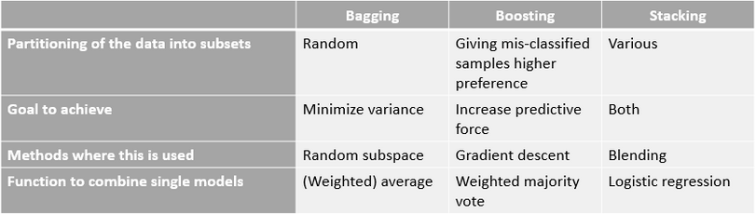
Notes:
Bias is the simplifying assumptions made by the model to make the target function easier to approximate.
High bias can cause an algorithm to miss the relevant relations between features and target outputs (underfitting).
Variance is the amount that the estimate of the target function will change given different training data.
High variance can cause an algorithm to model the random noise in the training data, rather than the intended outputs (overfitting).

Slide 20
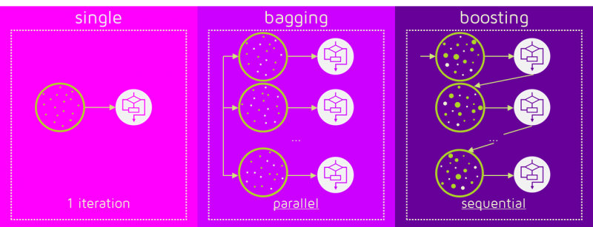
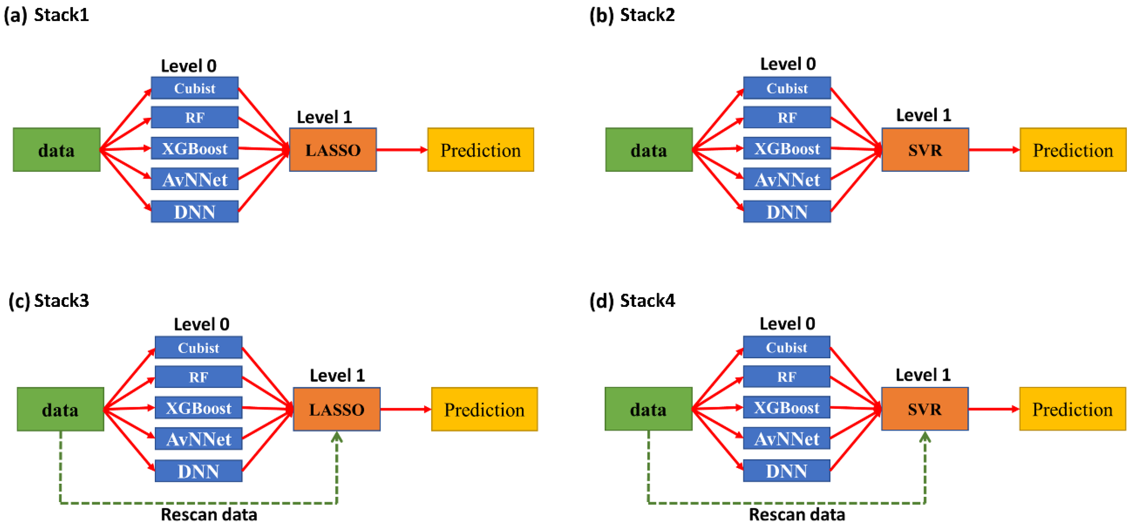

Slide 21
Colab Time ☺

Slide 22
Kahoot Time ☺

